Slide 1
Knowledge Processing Technology !ReaddIt
Team 7
KPT - Kooky Pizzazz Team
Nirup Ariana Vivek

Slide 2
Motivation
With our everyday life becoming more dynamic, people have less time to focus and read entire news articles
Provide a convenient and easy way to get information on news around the world
Visualizing news can greatly reduce the time needed to understand the content of an article
Visualize nodes (words) in a way that they logically present the flow of the storyline(s)

Slide 3
Key Issues
Reading long news articles can be
boring and
time consuming
Visualizations are always more appealing than lengthy texts.
As quoted by Fred R. Barnard:
“A picture is worth a thousand words”
Problem definition: Can we visualize the content of news articles in a graphical manner?

Slide 4
Related work
Topic Extraction from News Archive Using TF*PDF Algorithm (Khoo Khyou Bun and Mitsuru Ishizuka)
Terms that are related to hot topics at that time, appear more frequently.
Downside: useful only when there are viral news
Construction of news headline from detailed news article (Urmila Shrawankar and Kranti Wankhede)
Instead of reading an entire news article, reader can get an idea by just reading the headline.
Downside: partial information by reading just the headline

Slide 5
Our approach
Provide users with all the information they need in a short and concise manner
Utilize news from Inshorts
Provides news articles with 60 words or less
The structure of sentences is simple
Mixture of old and trending news
Use the content of the article rather than just the title
Most common parts of speech are used as nodes
Noun – verb – noun relationships are visualized

Slide 6
Our data
The data we used is collection of around 3000 articles
Articles have title, content, date and time, and image url

Slide 7
Token creation process
Text
Coreference resolution
POS tagging
Case folding
Stop word removal (punctuations, possesisve nouns and determinants)
Lemmatazation using POS tags
Tokens

Slide 8
Graph creation process
Token
Remove adverbs and adjective
Chunking
Graph

Slide 9
Generic Vector Space Model
Query: goods
Document 1: US President Donald Trump is in very good health despite his weight being in the obese range, according to his official doctor Sean Conley.
Document cosine similarity: 0.211
Document 2: Finance Minister Arun Jaitley has announced basic customs duty on all goods imported from Pakistan has been raised to 200% with immediate effect.
Document cosine similarity: 0.137

Slide 10
Vector Space Model using POS tags
Query: goods/NNS
Document 1: US President Donald Trump is in very good/JJ health despite his weight being in the obese range, according to his official doctor Sean Conley.
Document cosine similarity: 0.211
Document 2: Finance Minister Arun Jaitley has announced basic customs duty on all goods/NNS imported from Pakistan has been raised to 200% with immediate effect.
Document cosine similarity: 0.20

Slide 11
Validation
Validating a VSM is a challenging task.
User Happiness is an important metric in evaluating VSM performance.
User happiness is the same as retrieving articles that match the users’ query.
We have demonstrated that our model performs better than a regular VSM by considering the POS tag of the users’ query. By doing this, we are able to retrieve documents that both syntactically and semantically match the users’ query.
We asked 10 of our friends if they were happy with our retrieval, and all of them were. Although this is not a perfect metric, it gives us the overview of the system’s performance.

Slide 12

Android application

Slide 13
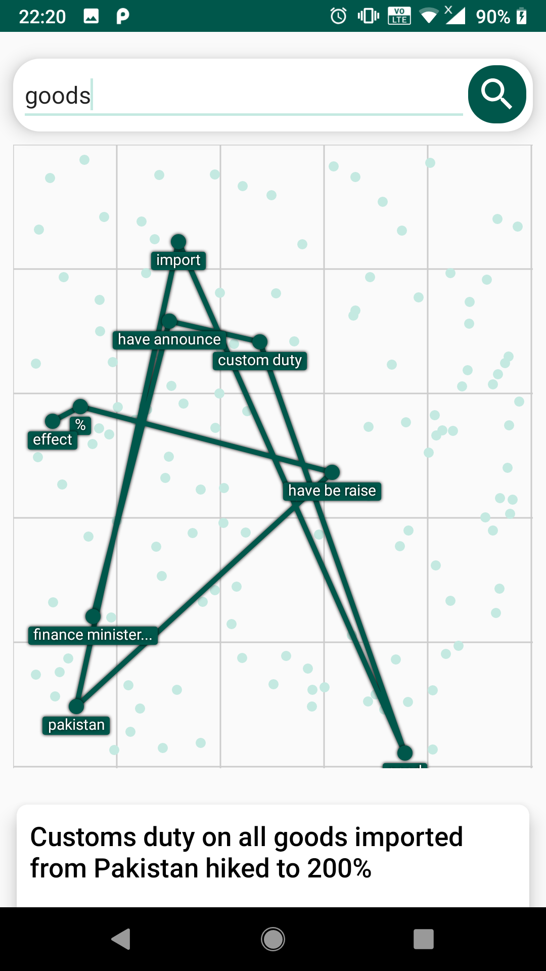
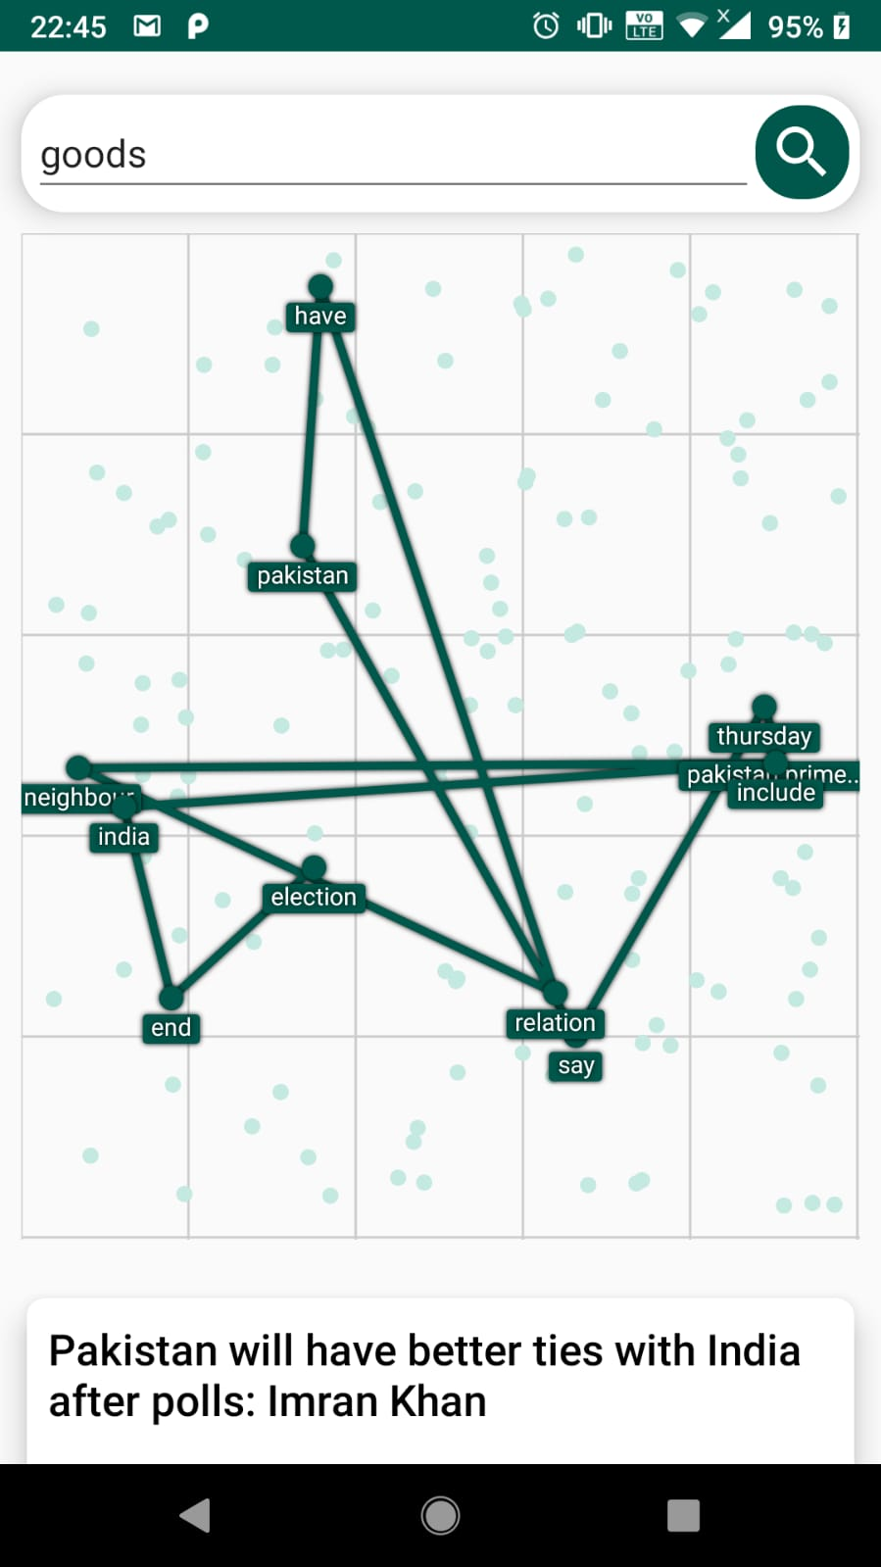
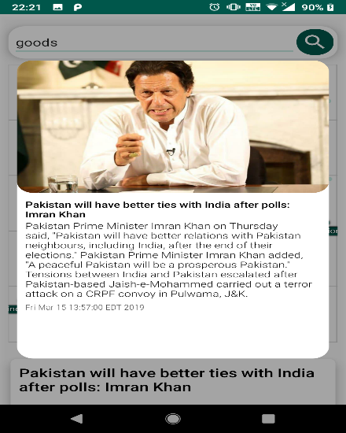
Android application – contd.

Slide 14
Conclusion
People keep themselves updated on current affairs through various media portals like newspapers, social media, TV news channels and so on. However, the information that we receive through these outlets is very particular or narrow and does not draw the entire picture.
Our model of a graph based news casting platform will solve this issue by visualizing all the elements and forces that act on a particular element. We do not construct the article. We show the occurrences of events, and thereby let the users see how each element is interconnected.
Our original method of upgrading the VSM to use POS tags is interesting approach and opens opportunities for further development.

Slide 15
Future Work
Our model can also be used in various other domains.
Can be used to graph a science textbook.
A student can use this graph to understand the concepts laid out in the book.
Can be used in judicial system to aid a judge in analysing the various forces that are acting on a person, which forced him/her to act the way that they did.
By clustering of the corpus, VSM ranking system can be significantly improved.

Slide 16

Thank you for your attention!

